Slide 1
Rescue Route Presentation
CPSC 335-16 Algorithms, Group 5
Presented by
Dawood Yaseer
Jimmy To
Brian Nguyen
15 October 2026

Slide 2

Brief Overview
RescueRoute is a Python class project that matches surplus food donations with community groups and volunteer drivers. It compares FIFO and greedy scheduling. Each donation gets an assignment or a reason why it could not be assigned. All sample data is made up for this project. This is a class model, not a food-safety system or a tool approved for real pickup work.

Slide 3
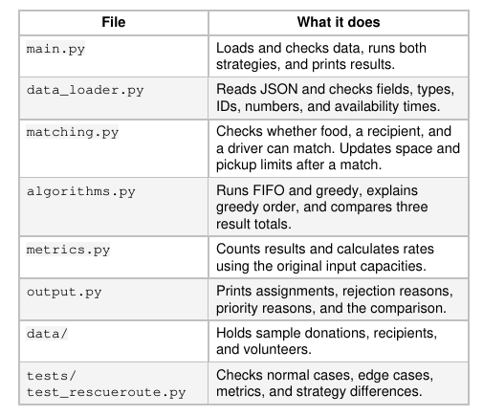
Architecture
The project’s code is split into several different files:
data_loader - reads the sample data and validates
matching - pairs appropriate assignments
algorithms - schedules according to FIFO/Greedy
metrics - calculates rates and any other relevant data
output - presents the assignments in a readable format
tests - unit tests to determine whether the functions correctly perform their action
data - holds the sample data (donations, volunteers, recipients)

Slide 4
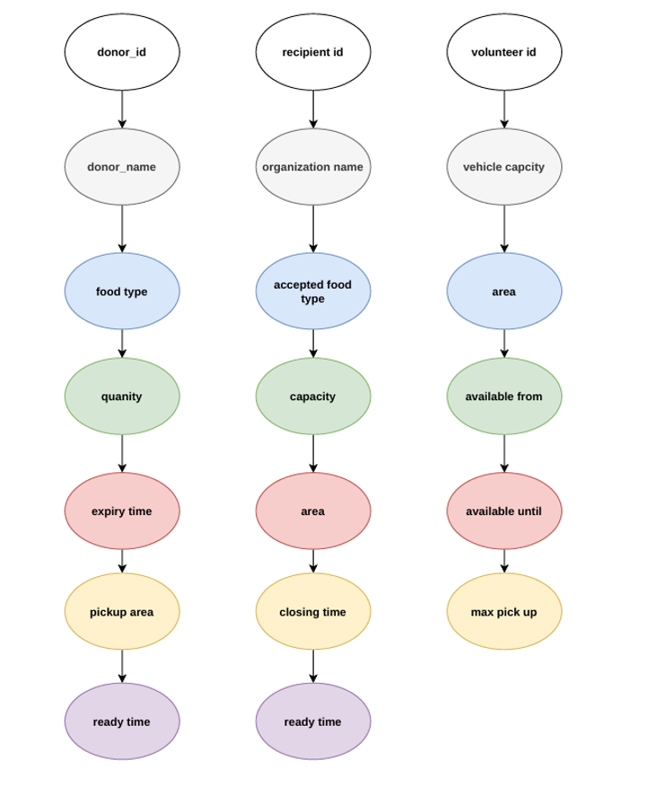
Data Schema
When it comes to the data for Rescue Route, we pull the data from three separate files:
donations.json
recipients.json
volunteers.json
The three files and the information that each dictionary holds can be found in the following slides.

Slide 5

donation.json
field | type | meaning
donation_id | text | Unique ID assigned to every donation
donor_name | text | Name of the donor
food_type | text | Category of food (produce/prepared_meals)
quantity | whole number, must be positive | number of units that donation provides
expiry_time | whole number, must be positive | expiration time within the clock
pickup_area | text | The area where the food must be picked up from
ready_time | whole number, must be positive | When the food becomes available for pickup

Slide 6
recipient.json
field | type | meaning
recipient_id | text | Unique Recipient ID within list
organization_name | text | Name of organization
accepted_food_types | list | The accepted food type that the organization will take
capacity | whole number, must be positive | The maximum capacity that the recipient can hold
area | text | The area in which the recipient resides
closing_time | whole number, must be positive | The time in which the organization closes and no longer accepts donations

Slide 7
volunteers.json
field | type | meaning
volunteer_id | text | Unique ID of volunteer
vehicle_capacity | text | Most units the volunteer can carry in a single pickup
area | text | Area that the driver resides in
available_from | whole number, must be positive | First minute that the volunteer is available
available_until | whole number, must be positive | When the volunteer becomes unavailable
max_pickups | whole number, must be positive | The maximum amount of pickups that a volunteer can do

Slide 8
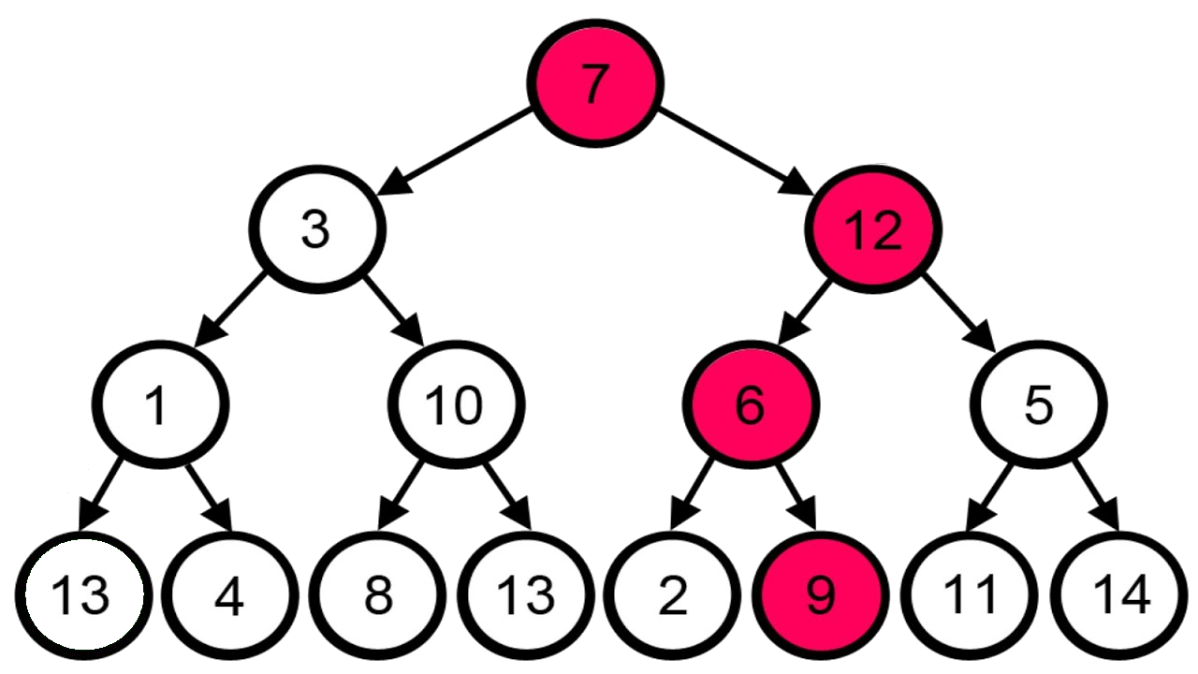
Greedy Rule
Our Greedy Rule goes as the following:
Earliest Expiry First
Larger quantity
Earlier Ready Time
If all of the previous match, then remain in input order

Slide 9
ALGORITHMS AND COMPLEXITY
D means donations, R means recipients, and V means volunteers.
Time complexity refers to how a function scales as input grows. Space means how much extra memory it uses.
Function | Worst-Case Time Complexity
schedule_fifo | O(D + V + D * R * V)
greedy_priority | O(1)
schedule_greedy | O(D log D + D + R + V + D * R * V)
calculate_metrics | O(D + R + V)
compare_strategies | O(1)

Slide 10

Testing
All 12 tests passed with no skipped tests on October 14, 2026.
1. Volunteer carrying-space use, including multiple pickups and zero capacity.
2. A normal match with the right recipient, driver, and pickup time.
3. Duplicate donation IDs.
4. Donations expiring before, at, and just after pickup time.
5. A recipient that does not accept the food type.
6. Greedy order and its explanation.
7. Too little recipient space and an exact-capacity match.
8. Small vehicles, unavailable drivers, and drivers with no pickups left.
9. Donations competing for space or pickups, without changing original inputs.
10. Empty lists, a JSON file containing `[]`, an invalid blank file, and zero rates.
11. Different FIFO and greedy choices on the same original data.
12. A later, larger donation getting priority over an earlier, smaller one.
We have 12 total tests that are used to determine whether the program functions correctly. The unit tests that our program conducts can be viewed here.

Slide 11
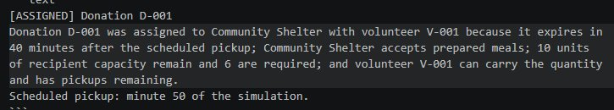
Sample Output
Donation ID
Area
Volunteer ID
Recipient Capacity
Expiration time remaining for donation
Accepted food types
Food capacity required for donation

Slide 12
Thank you

